Slide 1
Fraudulent Job Prediction System
Prepared By:
Bivek Adhikari
Shaswat Ghimire
Ankit Lamsal
Adarsha Bista

Slide 2
Table of contents
01
03
02
04
Modeling and Experiments
Introduction, Data Description and EDA
Baseline Model, Feature Engineering
Hyperparameter Tuning, Serialization and Demo

Slide 3
Introduction Data Description EDA
1

Slide 4
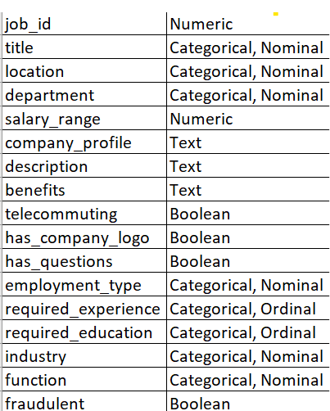
Introduction
Our dataset has 17 different columns, and has 17880 instances of the data.
By some data description techniques and EDA, we found out there were huge missing values and Uncleaned text data.
Our project is classification based and has imbalanced dataset. I.e. About 17014 instances are not fraud and 866 instances are fraud.

Slide 5
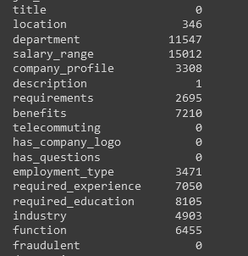
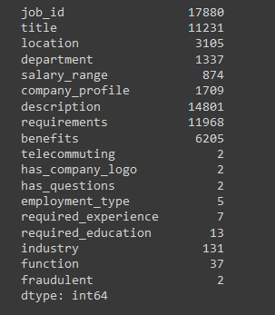
Data Description
Null Values in dataset rows.
Unique Values in dataset rows.

Slide 6
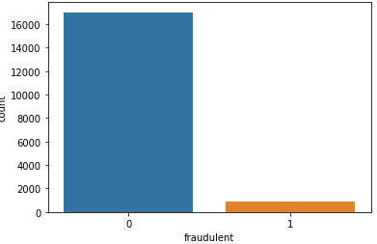
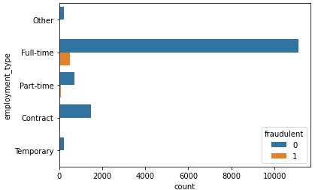
EDA
Count Plot of Fraudulent column.
Count Plot of Employment Type column with Fraudulent class.

Slide 7


EDA (Contd.)
Word Cloud Of Non Fraudulent Job Titles
Word Cloud Of Fraudulent Job Titles

Slide 8
2
Baseline Model Data Preprocessing - Label Encoding, Label Binarzing, Count Vectorizer, Tfidf, One Hot encoder, Text Preprocessing Feature Engineering - New columns (Country and state, is_na), Imputation, Text Cleaning

Slide 9
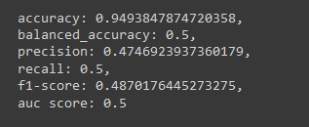
Baseline Model
We used DummyClassifier of Sci kit learn with strategy set as most-frequent .
We used ‘requirements’ and ‘title’ column for cleaning the text.
Split the data in Train and test data by ratio of 80-20.
Result of DummyClassifier

Slide 10
Preprocessing
For “Title” column we used CountVectorizer for getting matrix tokens.
For “Requirements” column we used TF-IDF features using TfidfVectorizer.
For “Functions” column we implemented binarization with LabelBinarizer.
For encoding data we used OneHotEncoder for “employment_type” & “industry” columns.
For some experimentation, we also used LabelEncoder .
We used nltk for tokenizing and lemmatizing the dataset.

Slide 11
Feature Engineering
Feature Addition
Following columns are added into the dataset for proper use:
“Location_isna”
“Description_isna”
“function_isna” and
“industry_isna”
`state` & `country` (by splitting `location` column )
`merged_text` (by using `requirements`, `company_profile` and `description` columns)
Feature Removal
- “Salary_range” column have 80% of overall rows are missing(Nan)
- “Department” column have 50% of overall rows are missing (Blank)
- “Company_profile”, “Has_questions” and “Requirements” are non descriptive and added noise to the dataset.

Slide 12
Feature Engineering (contd.)
Imputation
We first tried our Na Columns dataset by filling in mode values to categorical columns, median values to skewed numerical columns. While experimenting, we evaluated Logistic Regression but the result was near to DummyClassifier.
We also used RandomForestClassifier in ['employment_type','function', 'required_experience', 'industry', 'required_education', 'department’] using non-na columns value of dataset to predict na columns data.
Text Cleaning
We used Regular Expression, Tokenization (RegexpTokenizer), Lemmatization (wordnetLemmatizer) with the help of stop words.

Slide 13
3
Modeling - Model Training, Evaluation and Pipelining Experiments - Under sampling and Over Sampling

Slide 14
Modeling
The Dataset is split into 85-15 %. form.
We mostly used 3 different models for modeling:
Logisitic Regression (Default Parameters)
XGBoost (with 150 estimators, learning rate 0.3, maximum leaves of 3, maximum Depth 7 )
Random Forest (with 10 estimators, and Entropy as criterion)

Slide 15
Model Evaluation
We tried by training in 3 different form:
Title Columns Only,
Function and Title columns
All Columns.
Here is the Evaluation of the given Model with logistic Regression:
Feature Selected | Accuracy | Balanced Accuracy | AUC | Precision |  | Recall |  | F-1 Score
Title column | 96.62% | 63.52% | 63.52% | 0 | 0.97 | 0 | 1.00 | 0 | 0.98
 |  |  |  | 1 | 0.91 | 1 | 0.27 | 1 | 0.42
Function and Title Column | 96.62% | 63.92% | 63.92% | 0 | 0.97 | 0 | 1.00 | 0 | 0.98
 |  |  |  | 1 | 0.92 | 1 | 0.28 | 1 | 0.43
All Columns | 95.54% | 51.26% | 51.26% | 0 | 0.96 | 0 | 1.00 | 0 | 0.98
 |  |  |  | 1 | 1.0 | 1 | 0.03 | 1 | 0.05

Slide 16
Model Evaluation
For all features, We tried 3 different models given above. Here is the result. Here, 0 and 1 in precision, recall and f-1 score represent non-fraud and fraud classes.
Model | Accuracy | Balanced Accuracy | AUC | Precision |  | Recall |  | F-1 Score
LogisticRegression | 95.54% | 51.26% | 51.26% | 0 | 0.96 | 0 | 1.00 | 0 | 0.98
 |  |  |  | 1 | 1.0 | 1 | 0.03 | 1 | 0.05
RandomForest | 98.19% | 82.25% | 82.25% | 0 | 0.98 | 0 | 1.00 | 0 | 0.99
 |  |  |  | 1 | 0.94 | 1 | 0.65 | 1 | 0.77
XGboost | 98.5% | 86.41% | 86.41% | 0 | 0.99 | 0 | 1.00 | 0 | 0.99
 |  |  |  | 1 | 0.93 | 1 | 0.73 | 1 | 0.82

Slide 17

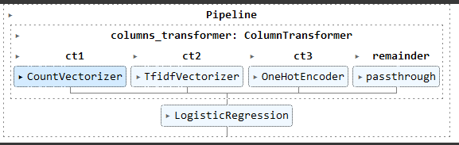
Pipelining
We used ColumnTransformer from sklearn to make 3 different columns. i.e. CountVectorizer (for `title` columns) and TfdifVectorizer (for `cleaned_text` column) and OneHotEncoder (for `function` column).
Here is the diagram of ColumnTransformer:
After Using Column Transformer, we now use Given model sequentially. As in diagram for LogisticRegression Below:

Slide 18
UnderSampling and OverSampling
We used Imblearn’s RandomUnderSampler (with sampling strategy of 0.8)and RandomOverSampler.
Here is the result of given experiment:
Model | Accuracy | Balanced Accuracy | AUC | Precision |  | Recall |  | F-1 Score
LogisticRegression (Both) | 86.86% | 86.79% | 86.79% | 0 | 0.89 | 0 | 0.87 | 0 | 0.88
 |  |  |  | 1 | 0.85 | 1 | 0.86 | 1 | 0.85
RandomForest (UnderSampling) | 86.86% | 86.79% | 86.79% | 0 | 0.89 | 0 | 0.87 | 0 | 0.88
 |  |  |  | 1 | 0.85 | 1 | 0.86 | 1 | 0.85
RandomForest (OverSampling) | 87.67% | 86.74% | 86.74% | 0 | 0.85 | 0 | 0.95 | 0 | 0.90
 |  |  |  | 1 | 0.93 | 1 | 0.78 | 1 | 0.85

Slide 19
4
Hyper parameter Tuning Member Contribution Demo

Slide 20
Hyperparameter Tuning
There were 3 different models used while Hyper parameter tuning:
Logistic Regression
Decision Tree
Random Forest
For all the models, we tried GridSearchCV to tune the appropriate hyperparameters:
Logistic Regression
Parameters | Values |  |  |  | Appropriate Value
Inverse Regularization Strength | 10 | 30 |  | 50 | 50
Solver | Newton-cg |  | liblinear |  | Newton-cg
Multi-class | Multi-nomial |  | Auto |  | Multi-nomial

Slide 21
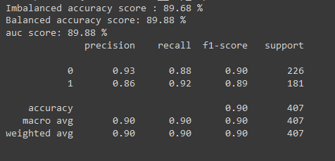
Hyperparameter Tuning (Contd.)
2. Decision Tree
Parameters | Values |  |  |  |  | Appropriate Value
Criterion | Gini |  | Entropy |  | Logloss | Entropy
Splitter | Best |  |  | Random |  | Random
Max Depth | 10 | 25 |  |  | 50 | 25
Minimal Cost Complexity Pruning Parameter | 0.001 | 0.001 |  |  | 0.1 | 0.01
Evaluation of tuned decision tree with appropriate values.

Slide 22
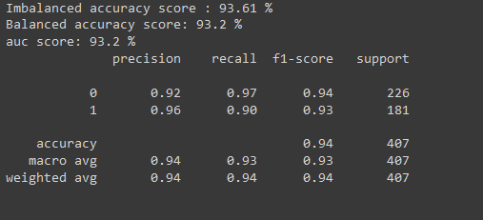
3. Random Forest
Parameters | Values |  |  | Appropriate Value
Criterion | Gini | Entropy | Logloss | Entropy
Max Depth | 10 | 25 | 50 | 50
Number of Estimators | 10 | 50 | 100 | 100
Minimum Sample Leaf | 2 | 5 | 10 | 2
Minimal Cost Complexity Pruning Parameter | 0.001 | 0.01 | 0.1 | 0.001
Evaluation of tuned Random Forest with appropriate values.

Slide 23
Members Contribution
Members | Contribution
Adarsha Bista | Model training, Model Evaluation, Sampling
Ankit Lamsal | Data Description, EDA, Sampling,
Bivek Adhikari | Pipelining, Hyperparameter Tuning, Model Serialization, Demonstration
Shaswat Ghimire | EDA, Data Preprocessing, Feature Engineering,

Slide 24
Thank You !!!

